Slide 1
Evolutionary Computing
Chapter 6
Popular Evolutionary Algorithm Variants
Part 2

Slide 2
Popular Evolutionary Algorithm Variants
Historical EA variants:
Genetic Algorithms (GA)
Evolution Strategies (ES)
Evolutionary Programming (EP)
Genetic Programming (GP)
More recent versions:
Differential Evolution (DE)
Particle Swarm Optimisation (PSO)
Learning Classifier Systems (LCS)
Estimation of Distribution Algorithms (EDA)

Slide 3
Differential Evolution: Quick overview
Developed: USA in 1995
Early names: Storn, Price
Typically applied to:
Nonlinear and non differentiable real valued functions
Attributed features:
populations are lists (sets where elements have a position)
four parents are needed to create a new individual
different variants exists due to changing the base vector
Special:
differential mutation

Slide 4
Differential Evolution: Differential mutation
Given a population of candidate solution vectors in IR^{n}
For every candidate, create a new mutant vector
A new mutant is produced by adding a perturbation vector to the old one:
where
the perturbation vector p is the difference between vectors y and z,
y and z are randomly chosen population members, and
scaling factor F>0 (differential weight) is a real number controlling the rate at which the population evolves

Slide 5
Differential Evolution: Uniform crossover
DE uses uniform crossover with
a crossover probability C_{r} that determines per position (gene) that the child inherits the value (allele) of the first parent
a restriction: at one randomly chosen position the child allele is taken from the first parent without making a random decision.
This restriction implies that duplication of the second parent is not possible.

Slide 6
Differential Evolution: Evolutionary cycle
Population is a list (ordering is not related to fitness value)
Step 1: create a mutant vector population
v_{i} = a_{i} + F × (b_{i} – c_{i}) where
a_{i} (≠ x_{i}) are randomly chosen base vectors from P
b_{i} and c_{i} (≠ x_{i}) are chosen randomly from P to define the difference vector
F is a scaling factor
Step 2: create trial vector population
where is made by uniform crossover between and
Step 3: deterministic selection applied to each pair x_{i} and u_{i}
where the best of x_{i} and u_{i} is chosen to be the i-th individual in next generation

Slide 7
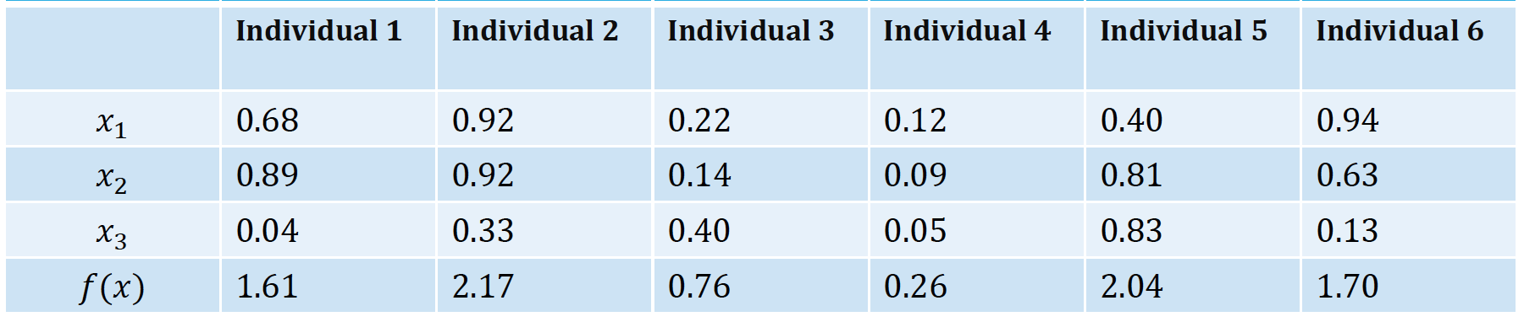
DE: Example with the hand
x_{i} denotes an attribute
of the fitness function
Minimize f(x) = x₁ + x₂ + x₃
Step 0: initialise the population
x_{i} denotes an attribute
of the fitness function

Slide 8
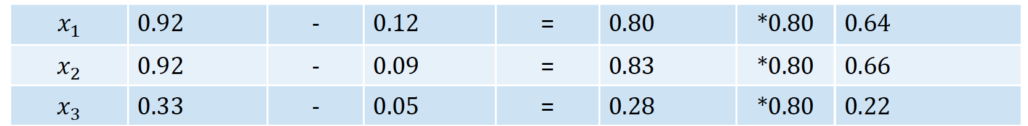
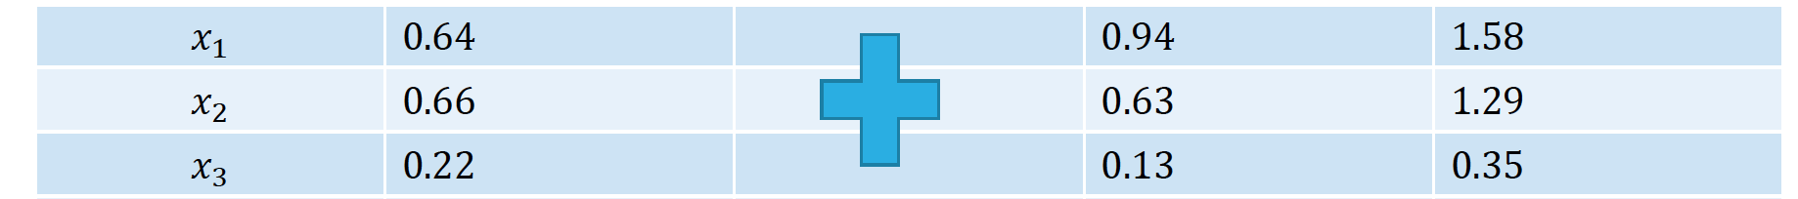
DE: Example with the hand
Step 1: create a mutant vector population
For each v_{i}, choose a_{i} (base) , b_{i} and c_{i} randomly from the population P different from x_{i}
v_{i} = a_{i} + F × (b_{i} – c_{i}), F= 0.8
x_{i} denotes a member
of the population
i = 1 b₁ = individual 2 c₁= individual 4 b₁ – c₁ F F × (b₁ – c₁)
F × (b₁ – c₁) a₁= individual 6 v₁= a₁ + F × (b₁ – c₁)

Slide 9
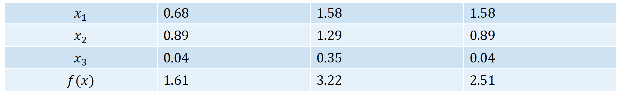
DE: Example with the hand
Step 2: create trial vector population by crossover
u_{i} is made by uniform crossover between x_{i} and v_{i} (note: one allele is fixed from first parent)
Step 3: deterministically select best of x_{i} and u_{i}
Thus: keep x₁
x₁ = individual 1 v₁ u₁

Slide 10
Differential Evolution: Different variants
Different variants exists due to changing the base vector
The variant is described as DE/a/b/c where a, b c are the placeholders for
a denotes the way to choose the base vector (rand or best)
b is the number of difference vectors to define perturbation vector. E.g., with b = 2 we use two difference vectors and we’d get
c denotes the crossover scheme (“bin” is uniform crossover)
DE/rand/1/bin is the notation for the version above

Slide 11
DE: Technical summary tableau
Representation | Real-valued vectors
Recombination | Uniform crossover
Mutation | Differential mutation
Parent selection | Given individual deterministically + Uniform random selection of the 3 necessary other vectors
Survivor selection | Deterministic elitist replacement (parent vs. child)

Slide 12

DE example: evolving Darth Vader picture
Individual represented as 18000 (gray scale) values in range [0,1]
Pop size = 400, F = 0.1, Crossover rate = 0.1
Fitness = squared difference value individual with target value (18000 dimensional function)

Slide 13
PSO: Quick overview
Developed: in the 1995
Early names: Kennedy, Eberhart
Typically applied to:
Optimising nonlinear functions
Attributed features:
No crossover
Every candidate solution carries it own perturbation vector

Slide 14


PSO: Quick overview
Special:
Inspired by social behavior of bird flocking/fish schooling
Particles with location and velocity instead of individuals with genotype and mutation

Slide 15
PSO: Main idea
Every population member / individual is a pair where
is a solution vector in IR^{n}
is a perturbation vector in IR^{n} of this
The perturbation vector determines how the solution vector is changed to produce a new one:
where is calculated from and some additional info
Note the similarity with ES and EP:
First we make a new p’ then
With the new p’ we create a new x’

Slide 16
PSO: Representation + variation sketch
Metaphor is “spatial” instead of “genetic”, thus
Every particle (= population member = individual) is a pair of
is a position vector (location) in IR^{n}
is a velocity vector in IR^{n}
New velocity vector is the weighted sum of 3 components:
Current velocity vector
Vector from current position to best past position of this particle
Vector from current position to best past position of the population
Note:
Personal best must be remembered, thus particles need to be extended
Populations best is general, not particle specific, needs general archive

Slide 17
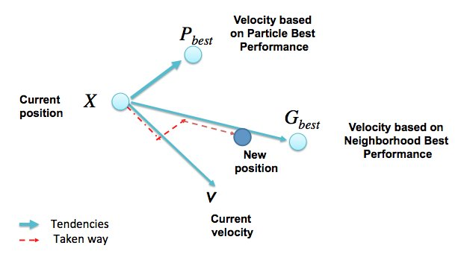

Slide 18
PSO: detailed representation + variation
A particle = individual = population member i is a 3-tuple of
a position vector (location)
a velocity vector
a best position vector of this particle in the past
Each triple is replaced by the mutant triple
where w and Φ_{i} are the weights and U₁ and U₂ randomizer matrices and denotes the populations global best
Relation to sigma first rule in ES?

Slide 19
PSO: individual and social factors
individual
social
The value of w can control exploration and exploitation
For w > 1
Velocities increase over time
Swarm diverges
For 0 < w < 1
Particles decelerate

Slide 20
PSO: Technical summary tableau
Representation | Real-valued vectors
Recombination | None
Mutation | Adding velocity vector
Parent selection | Deterministic (each parent creates one offspring via mutation)
Survivor selection | Generational (offspring replaces parents)

Slide 21
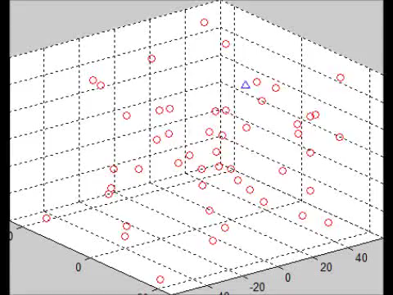
PSO: Example moving target
Optimum moves randomly through search space
Particles do not know position of optimum but do know which particle is closest and are attracted to that one
Precondition: low w value, personal best (b) is zero

Slide 22
Estimation of Distribution Algorithms
An algorithm always has certain downsides (see the No Free Lunch Theorem in the Theory chapter)
New algorithms are developed to overcome these downsides
Downside of an EA? With mutation and crossover you don’t learn much about the fitness landscape
Model-Based EAs try to model a distribution from the population and generate new solutions from this model

Slide 23

Estimation of Distribution Algorithms

Slide 24
EDA Quick Overview
Create initial population randomly
Calculate fitness of each candidate
Select a subpopulation (consisting of the best candidates)
Select a model to fit a probability distribution over the candidates
Sample new population from this estimated distribution
Back to step 2

Slide 25
Model-assisted EAs
EDAs build and use a model in the reproduction step
One could also build an use a model in the fitness evaluation step
Rationale:
fitness evaluation is by far the most time consuming step in an EA
sampling a model is usually much faster
the model building overhead could pay off (and it does!)
Idea: x% of fitness evaluations is real, 100-x% is model based

Slide 26
LCS: Quick overview Michigan-style
Developed: First described in 1976
Early names: Holland
Typically applied to:
Machine learning tasks working with rule sets
Giving best response to current state environment
Attributed features:
Combination classifier system and learning algorithm
Cooperation (instead of the usual competition) among individuals
Relies on genetic algorithms
Two schools: Michigan-style (rule is an individual) vs Pittsburgh-style (rule set is an individual)

Slide 27
LCS: Representation
Classic representation: each rule of the rule base is a tuple {condition:action:payoff}
where payoff is the fitness
Match set: subset of rules whose condition matches the current inputs from the environment
Action set: subset of the match set advocating the chosen action
In later versions, the rule-tuple included an accuracy value, reflecting the system’s experience of how well the predicted payoff matches the reward received

Slide 28
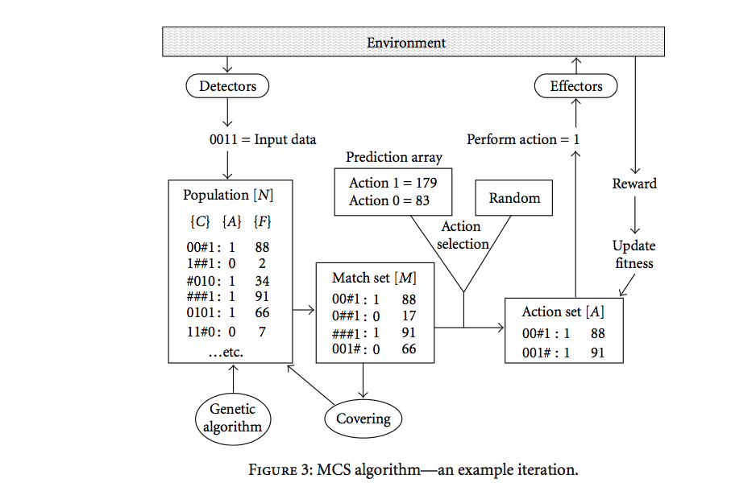
LCS: Iteration
# means a
wildcard
(don’t care)
179 > 83
explore
exploit
Makes new rules
Makes new rules
“Covering” for the case of an empty Match set by producing random new rules

Slide 29

Learning Classifier Systems: Example

Slide 30
LCS: Technical summary tableau Michigan-style
Representation | Tuple {condition:action:payoff,accuracy} conditions use {0,1,#} alphabet
Recombination | One-point crossover on conditions/actions
Mutation | Binary resetting as appropriate on action/conditions
Parent selection | Fitness proportional with sharing within environmental niches
Survivor selection | Stochastic, inversely related to number of rules covering same environmental niche
Fitness | Each reward received updates the predicted pay-off and the accuracy of rules in relevant action sets by reinforcement learning

Slide 31
Important points
There are several incarnations / dialects / variants of the generic EA scheme
The classic variants are: GA, ES, EP, GP
Some of these have a primary application area:
GA: discrete / combinatorial optimization
ES: continuous optimization
GP: machine learning, modeling
Methods and tricks invented in one branch can be often applied in other ones
Some techniques, e.g., PSO, use non evolutionary metaphors, but the algorithm follows the generic EA template
Beware of “novel” metaphors with bombastic names – these may be equivalent to existing variants !
The specific type of EA is not important for applications
Best approach in practice:
choose representation to fit the problem,
choose variation operators to fit representation
choose selection operators that work well
do not bother whether the resulting algorithm is variant A, B, or C ☺

Slide 32
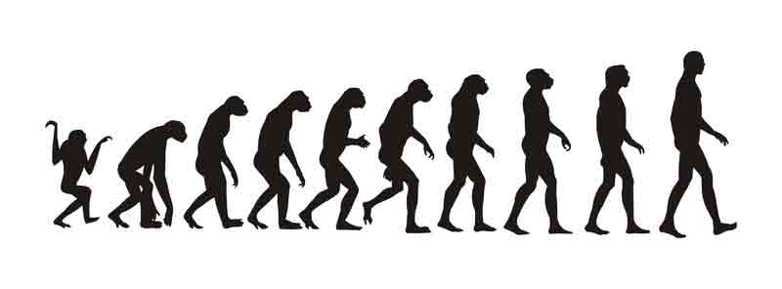
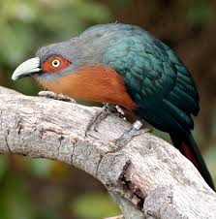
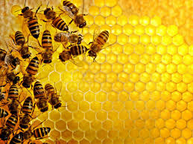

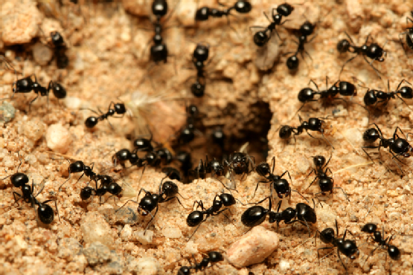

Current problem: too many metaphors

Slide 33
K. Sörensen, Metaheuristics – the Metaphor Exposed, Intl. Trans. in Op. Res. 22 (2013) 3–18
Metaphors have been useful in exploring the possibilities of the research field of heuristic
BUT
Most “new” methods are just repacking of old ideas with a new vocabulary (intelligent water drops, cockoo search, harmony search, honey bee swarm, fruit fly)
Role of metaphors changes from inspiration to justification and “proof” of novelty
Consequences: discredits solid metaheuristics, publication bias, redirects efforts from useful to useless research

Slide 34
Food for thought
Consider the following papers (Canvas):
Kenneth Sörensen, Metaheuristics – the Metaphor Exposed, Intl. Trans. in Op. Res. 22 (2013) 3–18 – READ
Geem, Z.W., Kim, J.H., Loganathan, G.V., 2001. A new heuristic optimization algorithm: harmony search. Simulation 76, 2, 60–68. – just browse
Discuss if and how the “novel” harmony search components relate to components in heuristics and evolutionary algorithms

